Slide 1
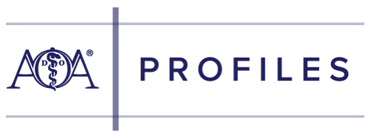
Osteopathic Profession
Kathleen S. Creason, MBA
Executive Director
American Osteopathic Information Association

Slide 2
Current initiatives
DO Stats
Board Certification
AOA Update

Slide 3
DO stats
135,000
DOs in US
11%
of physicians
26%
med students

Slide 4
DO stats
43%
Female
67%
< age 45
56%
Primary Care

Slide 5
Aoa Board certification*
16
Boards
27
Specialties
49
Sub-specialties
*Open to DOs and MDs

Slide 6
Early entry pathways
Family Medicine
Internal Medicine

Slide 7
Aoa update - external
2020: first combined NRMP match
Residency programs with Osteopathic Recognition

Slide 8
Aoa update - internal
Transitioning member database
Return to work: April 4

